Slide 1
Real vs. Fake News Classification
Allison Beatty (yxn127)
Joshua Ching (mrf145)
Ruyi Liang (hua075)
Ian Scarff (iie728)
Notes:
Allison

Slide 2
Background
The internet and social media have connected the world in more ways than ever.
News media has come to heavily rely on social media to reach readers.
Some organizations have also spread false information and narratives, claiming it as legitimate news.
These types of articles and stories have commonly been classified under the term “Fake News.”
Notes:
Allison

Slide 3
Motivation
Our analysis aims to develop a model to classify a news article as “Real” or “Fake” based on the article’s text. Answer the following questions:
Is it possible to classify the type of news article based on the 100 most used words in the article?
What kinds of words are important predictors for classification?
Is the time of year an important classifier?
Notes:
Allison

Slide 4

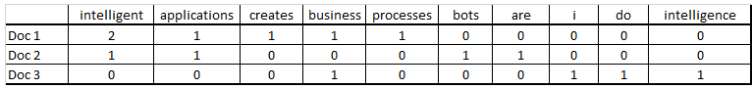
Review of Literature
Text mining and predictive modeling have been combined many times.
Text Mining in Practice with R, Chapter 7 lists some case studies:
Will This Patient Come Back to the Hospital?
Examined patient records to see if patient would be readmitted.
Predicting Box Office Success.
Examined movie reviews to predict movie’s opening weekend revenue.
Key Data Structure: Document Term Matrix (DTM):
A matrix that describes the frequency of terms that occur in a collection of documents.
Kwartler, Ted. “Predictive Modeling: Using Text for Classifying and Predicting Outcomes.” Text Mining in Practice with R, John Wiley & Sons, Ltd, 2017, pp. 209–36, doi:10.1002/9781119282105.ch7.
https://www.darrinbishop.com/blog/2017/10/text-analytics-document-term-matrix/
Notes:
Allison

Slide 5
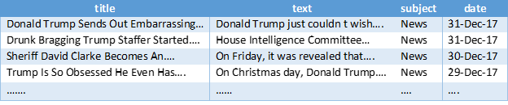
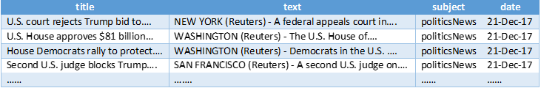
The Data
Fake.csv
Two seperate files: True.csv, Fake.csv.
Fake.csv contains fake news article (23,481 observations).
True.csv contains real news articles (21,417 observations).
True.csv
Source: https://www.kaggle.com/clmentbisaillon/fake-and-real-news-dataset
Source Acknowledgements:
Ahmed H, Traore I, Saad S. “Detecting opinion spams and fake news using text classification”, Journal of Security and Privacy, Volume 1, Issue 1, Wiley, January/February 2018.
Ahmed H, Traore I, Saad S. (2017) “Detection of Online Fake News Using N-Gram Analysis and Machine Learning Techniques. In: Traore I., Woungang I., Awad A. (eds) Intelligent, Secure, and Dependable Systems in Distributed and Cloud Environments. ISDDC 2017. Lecture Notes in Computer Science, vol 10618. Springer, Cham (pp. 127-138).
Notes:
Ian

Slide 6
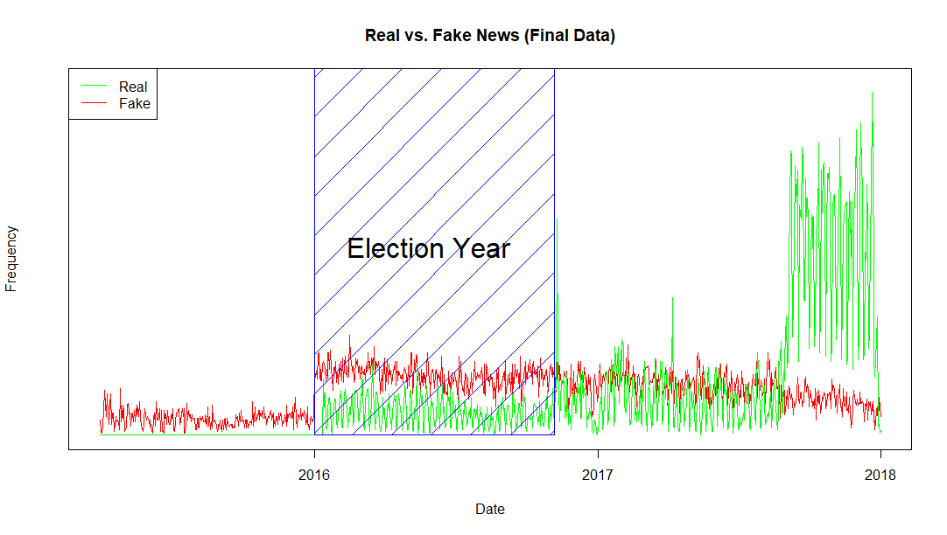
The Data (cont.)
Together these datasets span the time frame of 03/31/2015 to 12/31/2017.
Notes:
Ian

Slide 7
Data Preprocessing
True.csv data & Fake.csv data was combined.
News Type category was added (Real or Fake).
Month was extracted into separate column.
Deleted any duplicate observations.
Article text from Fake News was text mined to find most common words.
Notes:
Ian

Slide 8

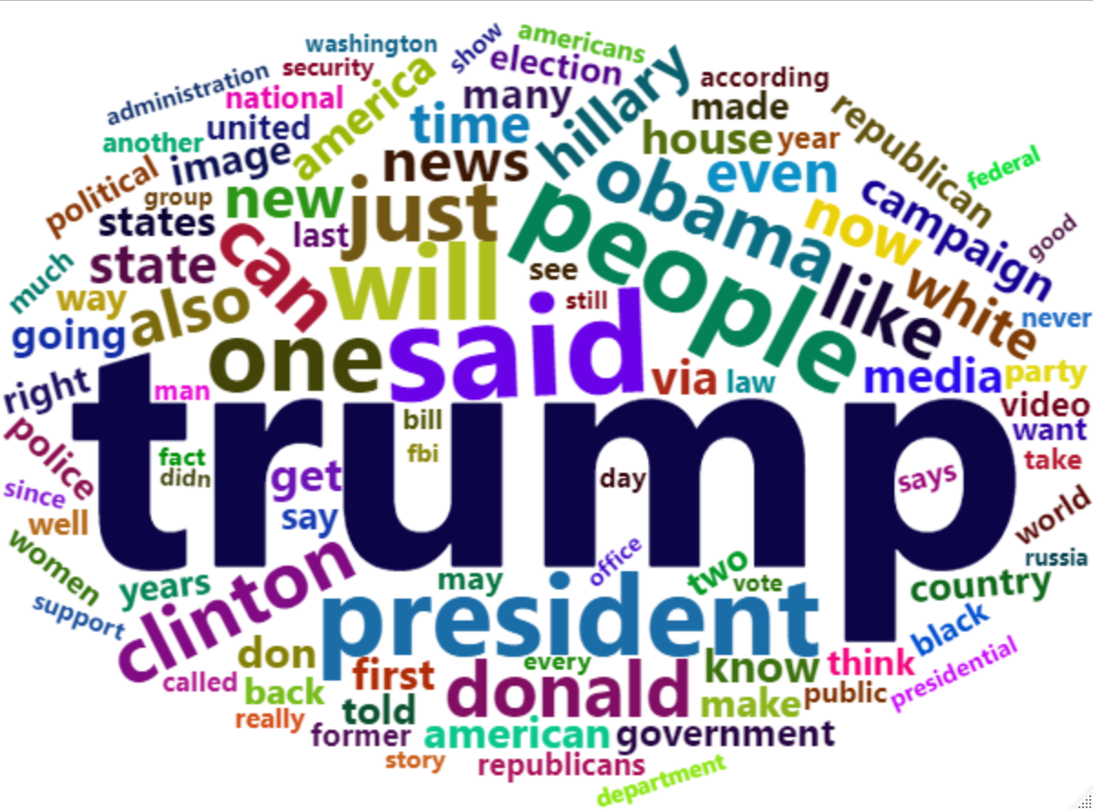
Data Preprocessing (cont.)
Fake News Wordcloud
Top 100 Fake News Words WordCloud
Extracted top 100
Notes:
Ian

Slide 9
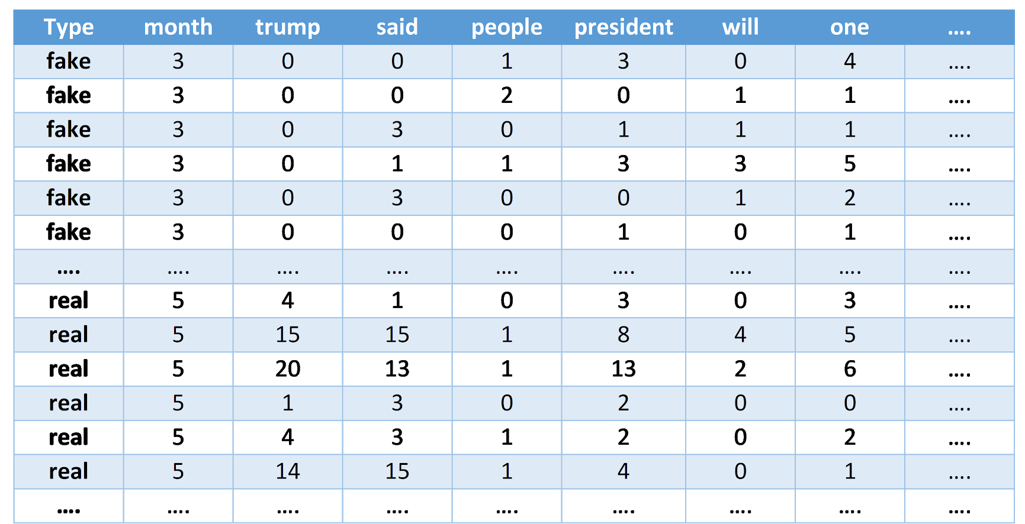
Data Preprocessing (cont.)
Top 100 words in Fake News turned into columns (ordered from most to least common).
Observations are the frequencies of the words in an articles text. A DTM.
Final Data: 38,604 observations, 102 Variables.
Final Data
Notes:
Ian

Slide 10
Exploratory Analysis
Notes:
Josh

Slide 11
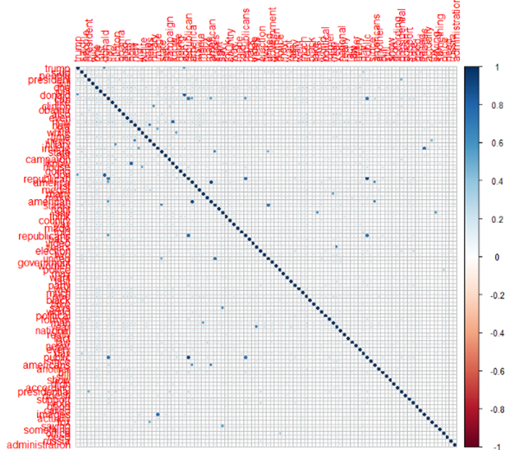
Correlation of Word Frequencies
Word Frequency Correlation Pot
Full Data
Some strong correlations between some words.
Could be that these words appear next to each other in a sentence naturally.
Hillary Clinton
Donald Trump
Same story for:
Fake vs. Real data
By month
Notes:
Josh

Slide 12
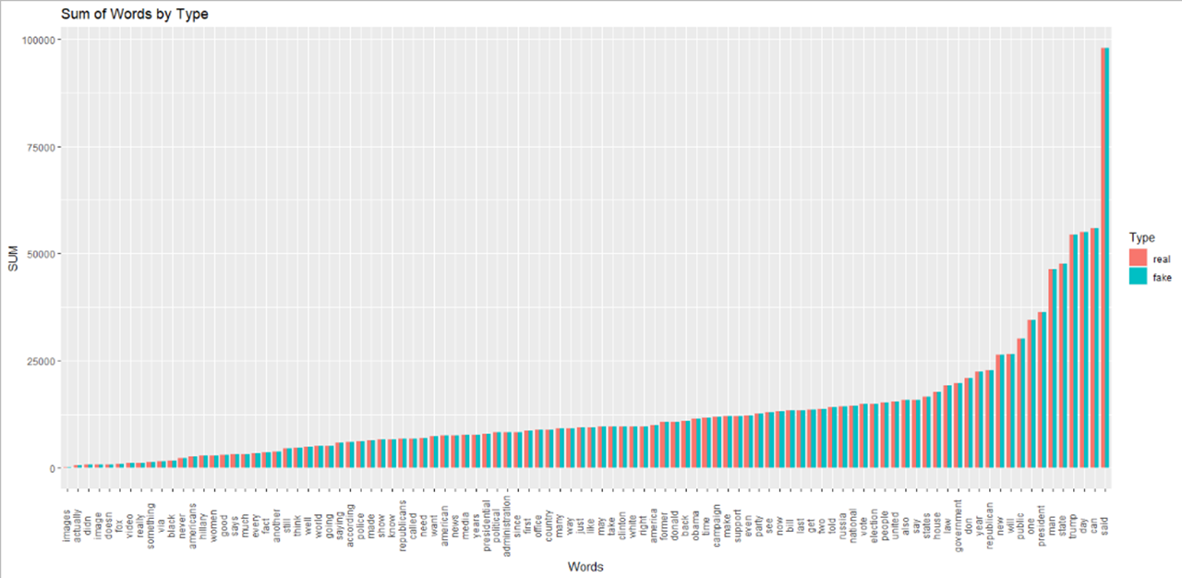
Word Frequencies Total
Total frequencies for each word are similar for each news type.
Notes:
Josh

Slide 13
Analysis Methodology
Target Variable:
News Type
Predictors:
Top 100 Word Frequencies
Month
Stratified Random Sampling:
80% Training Data (30,884 observations)
20% Test Data (7,720 observations)
Models: (built using “caret” package)
Logistic Regression
Decision Tree
Neural Network
Random Forest
Prediction threshold: 75%
Comparing Models:
Test Accuracy
Test Error Rate
ROC Curves
Area Under Curves
Notes:
Josh

Slide 14
Results
Notes:
Ian

Slide 15
Logistic Regression
Notes:
Ian

Slide 16
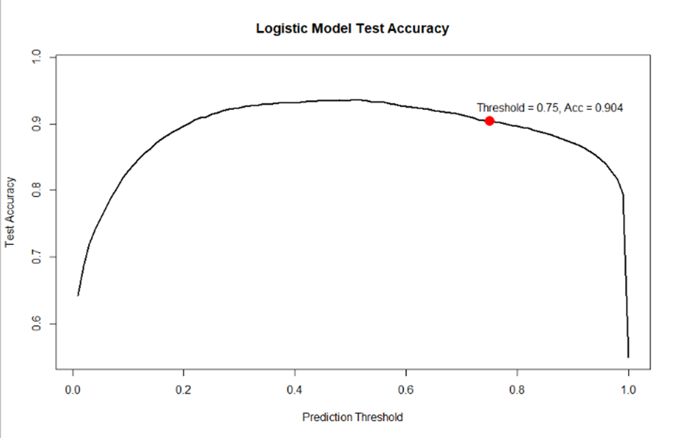
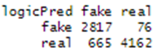
Accuracy
Notes:
Ian

Slide 17
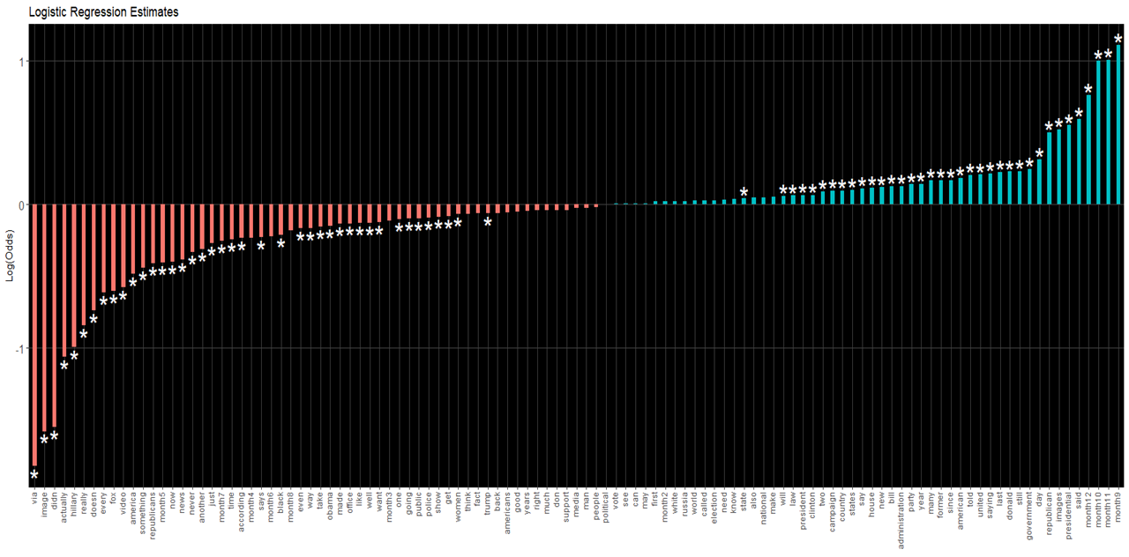
Model Summary
Δ Odds of Fake:
■ Decreases ■ Increases
* Significant at α = 0.05
Notes:
Ian

Slide 18
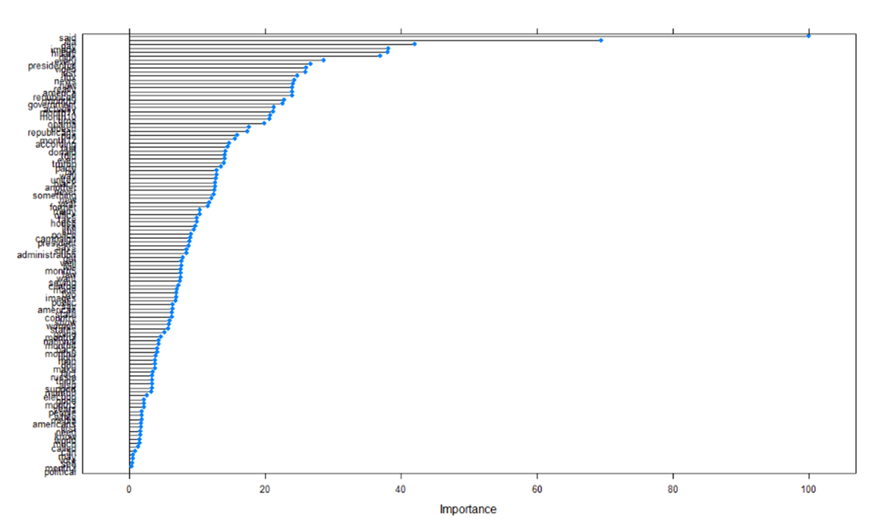
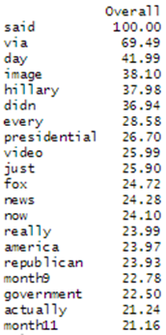
Variable Importance
Notes:
Ian

Slide 19
Neural Network
Optimal Hyperparameters:
size = 8
decay = 0.5
Notes:
Allison

Slide 20
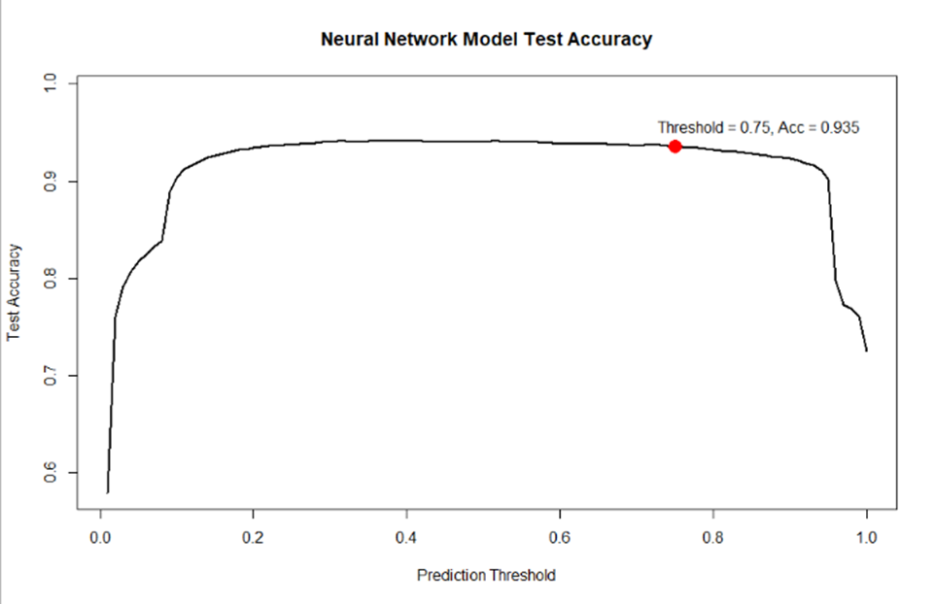
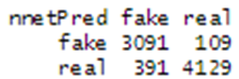
Accuracy
Notes:
Allison

Slide 21
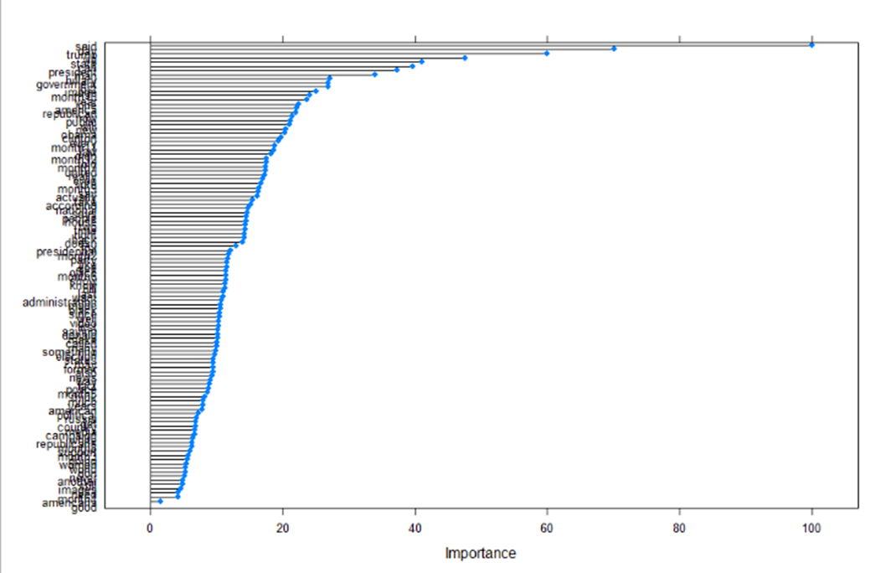
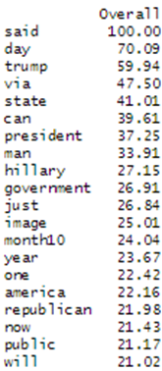
Variable Importance
Notes:
Allison

Slide 22
Decision Tree
Optimal Hyperparameter:
cp = 0
Notes:
Josh

Slide 23
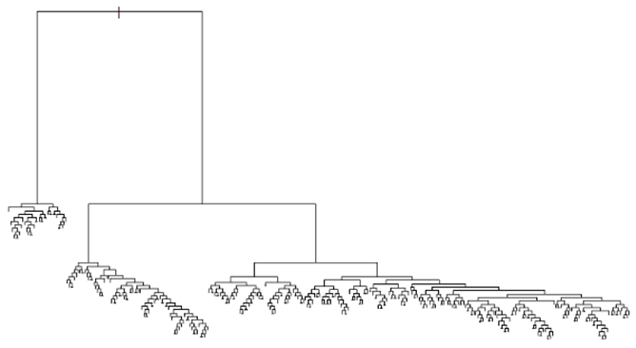
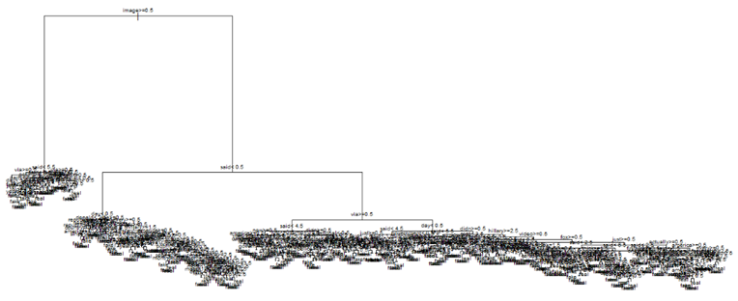
Notes:
Josh

Slide 24
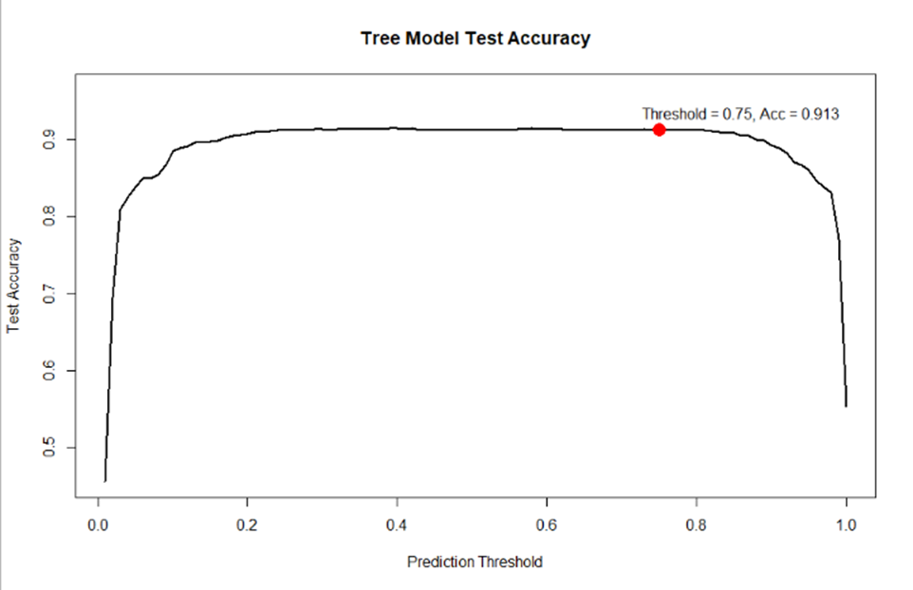
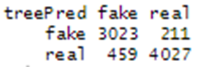
Accuracy
Notes:
Josh

Slide 25
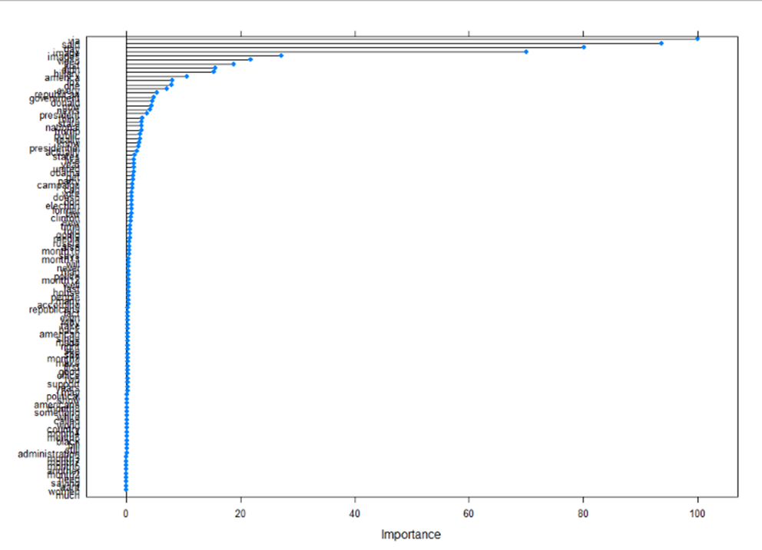
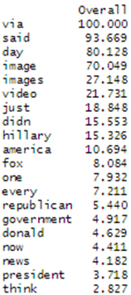
Variable Importance
Notes:
Josh

Slide 26
Random Forest
Optimal Hyperparameter:
mtry = 4
Notes:
Ruyi

Slide 27
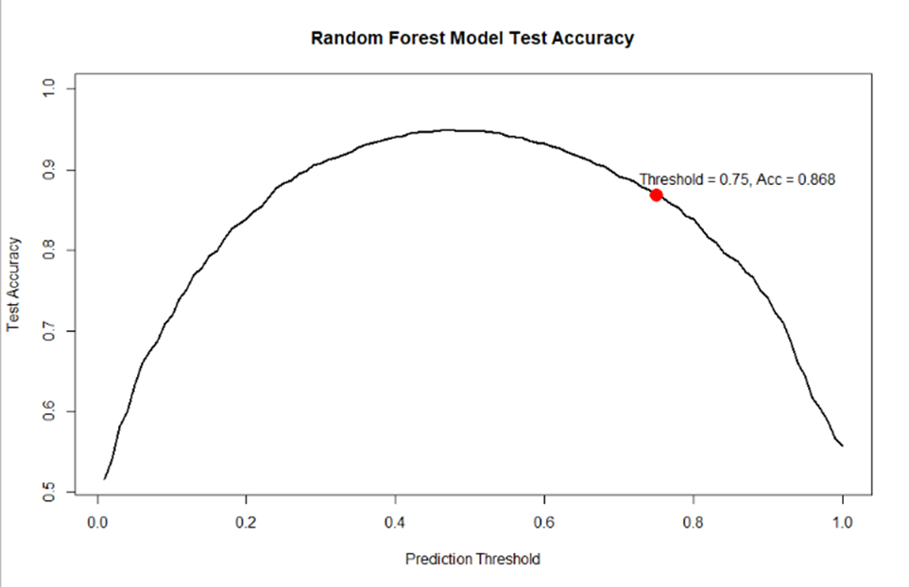
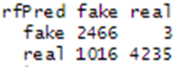
Accuracy
Predicting real when it’s actually fake. Not good.
Neural Network had the lowest number of 391.
Notes:
Ruyi

Slide 28
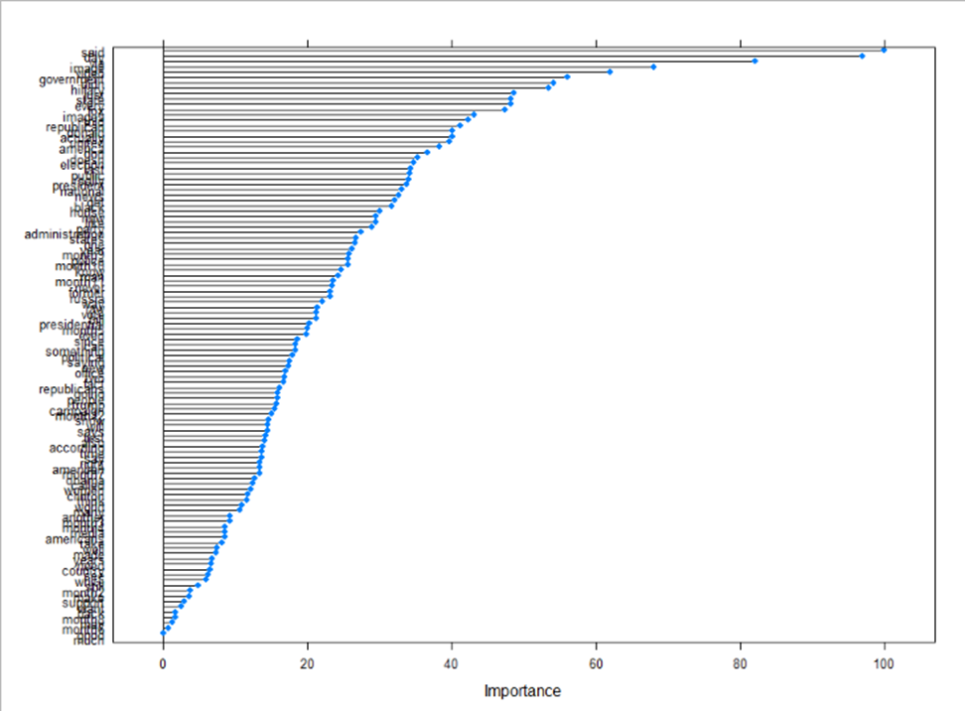
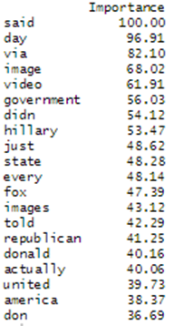
Variable Importance
Notes:
Ruyi

Slide 29
Model Comparison
Notes:
Ruyi

Slide 30
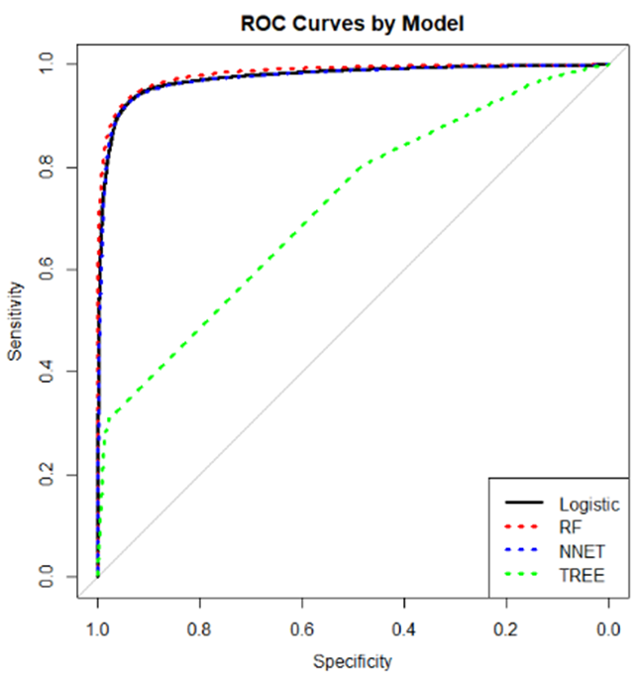
ROC Curves
Notes:
Ruyi

Slide 31
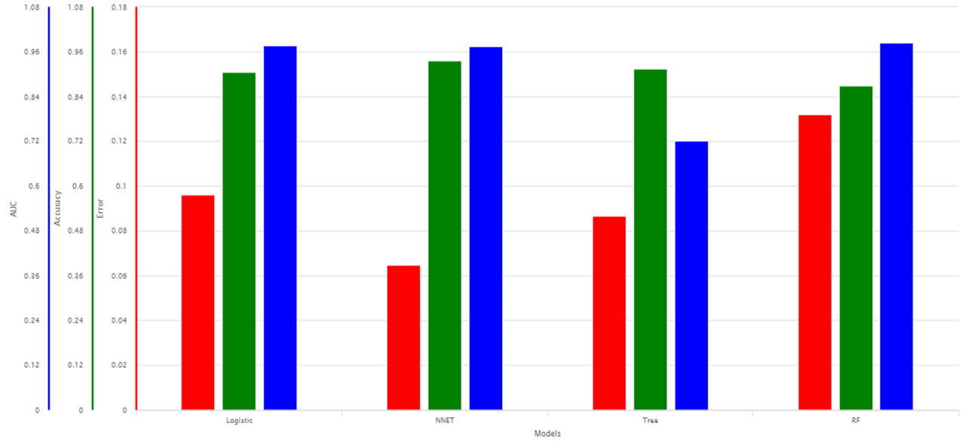
Comparing Statistics
Notes:
Ruyi

Slide 32
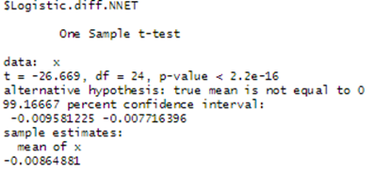
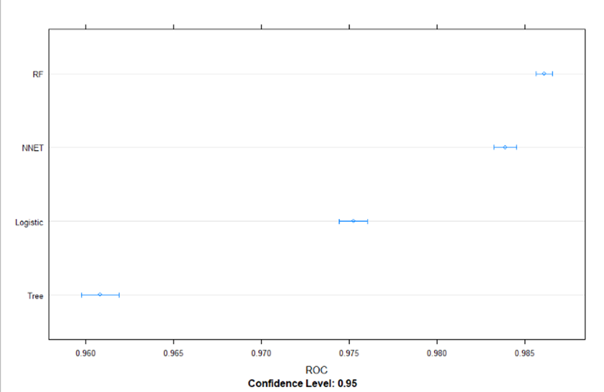
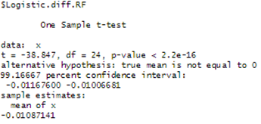
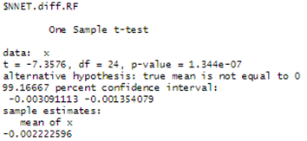
Model Differences
Notes:
Ruyi

Slide 33
Which Model is Best?
Neural Network:
Has similar Area Under Curve as Logistic and Random Forest.
Has highest test accuracy at 75% prediction threshold.
Has lowest False Negative Rate (Type II Error).
Predicting “real” when true is “fake.”
Disadvantages:
Second highest False Positive Rate (Type I Error).
Model Complexity.
Processing Time.
“Black Box” Nature.
Notes:
Ruyi

Slide 34
Recommendations & Future Work
Notes:
Allison

Slide 35
Recommendations & Future Work
Recommendations:
Use Neural Network model for classifying news articles.
Use Logistic Regression to understand how various words affect probability/odds of news type.
Set up a flagging system for articles that are near prediction threshold.
Mitigate Type II Error
Set up appeal system for human review for organizations who feel their article has been misclassified.
Mitigate Type I Error.
Future Study:
Explore more words, word combinations.
Extract news source as a predictor.
Determine news topic, use as predictor.
Notes:
Allison

Slide 36
Questions?
Notes:
Allison

